Slide 1

Parallel algorithms for the analysis and synthesis of data
Andriushchenko Petr, PhD

Slide 2
Minute of history

Slide 3
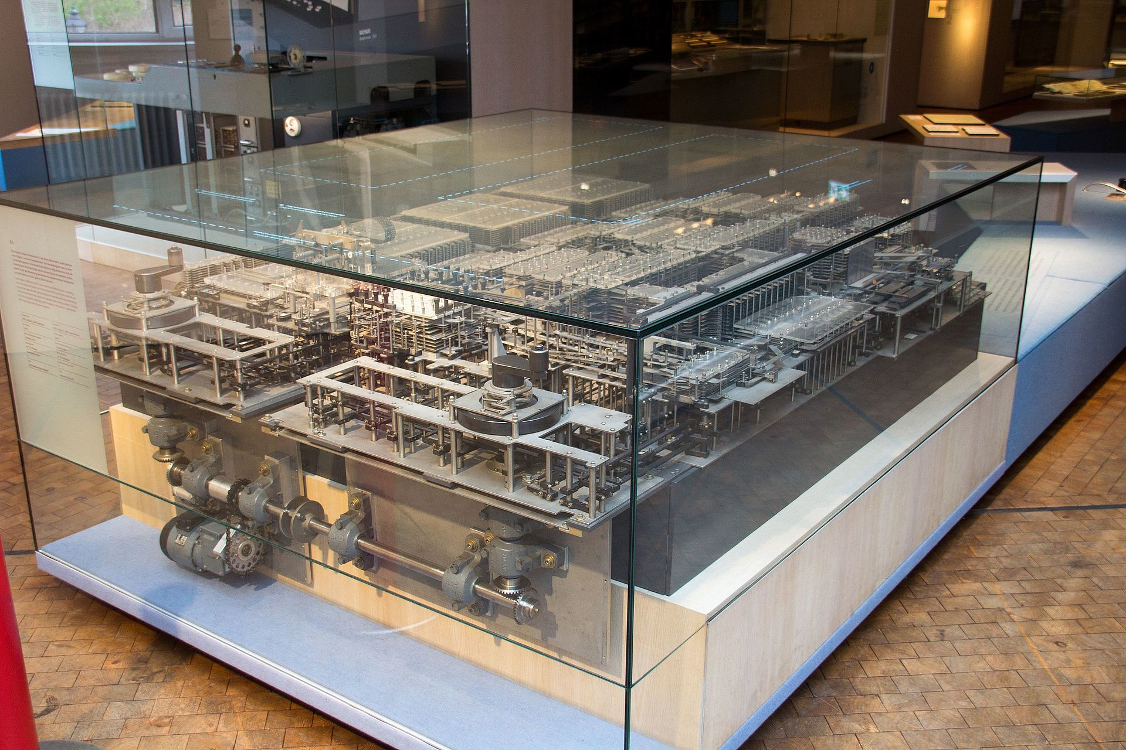
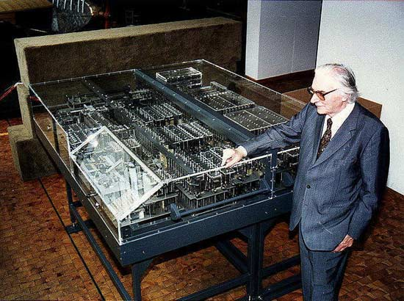
Short history
1820s Difference engine Charles Babbage
1936-1938 Z1(prototype) Konrad Zuse 1Gz 1KW 500KG

Slide 4
Short history
1820s Difference engine Charles Babbage
1936-1938 Z1(prototype) Konrad Zuse 1Gz 1KW 500KG
1938-1939 Z2(prototype) Konrad Zuse 5Gz 1KW 500KG
12.05.1941 Z3 Konrad Zuse 5.3Gz 2Flops 2600 telephone relays 4KW
1950 Z4 Konrad Zuse 40Gz 6KW

Slide 5
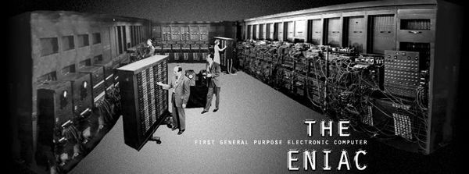
Short history
1942 ENIAC 100kGz 174KW 27000KG (167 m2)
18000 vacuum tubes, 7200 crystal diodes, 1500 relays, 70000 resistors, 10000 capacitors, and approximately 5 000 000 hand-soldered joints.

Slide 6
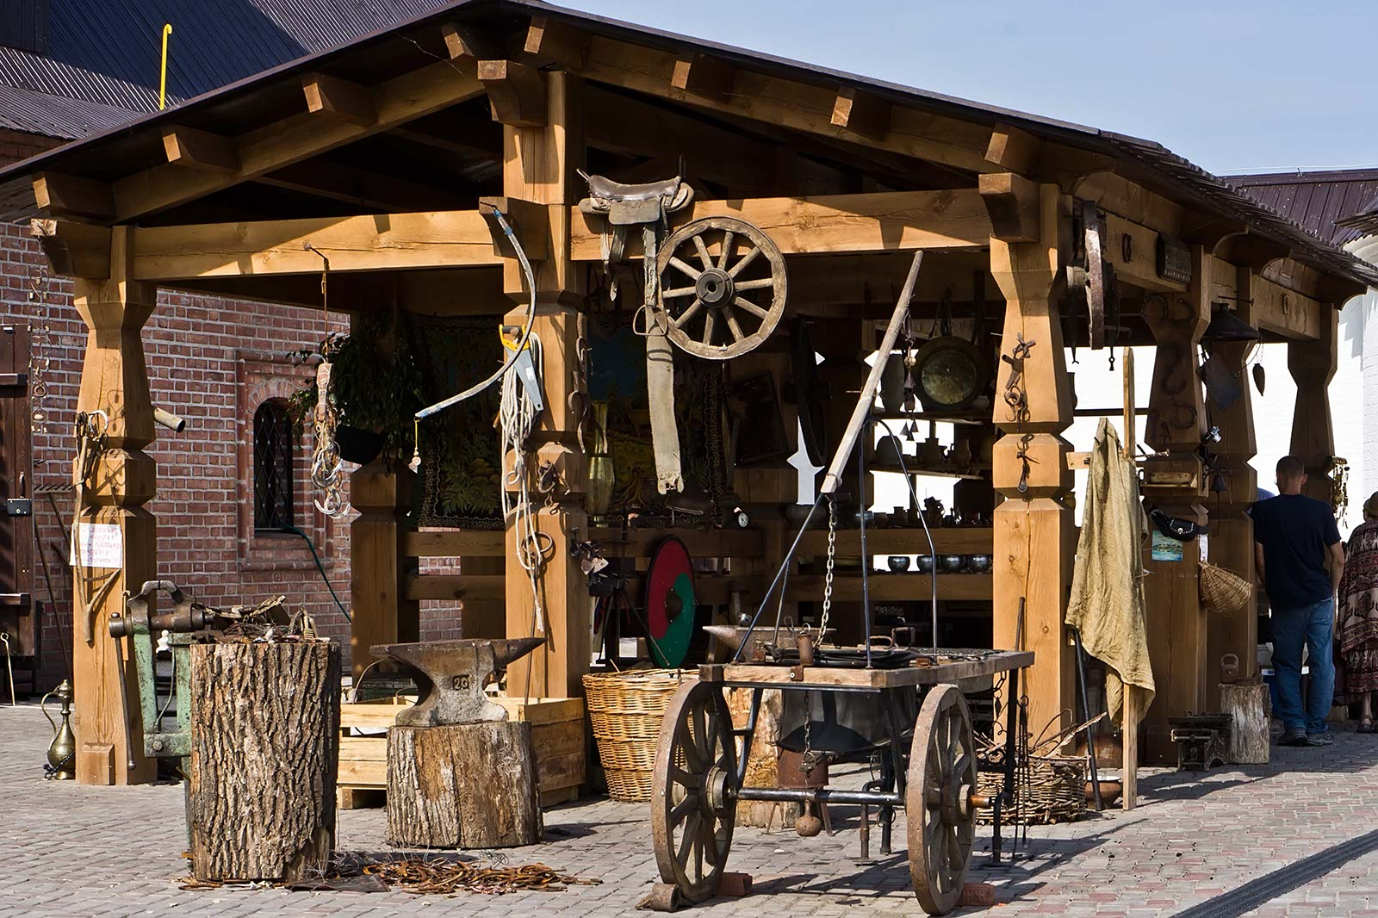
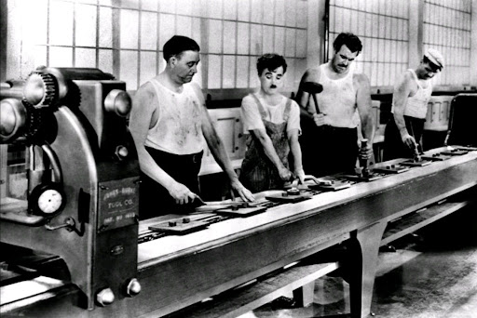
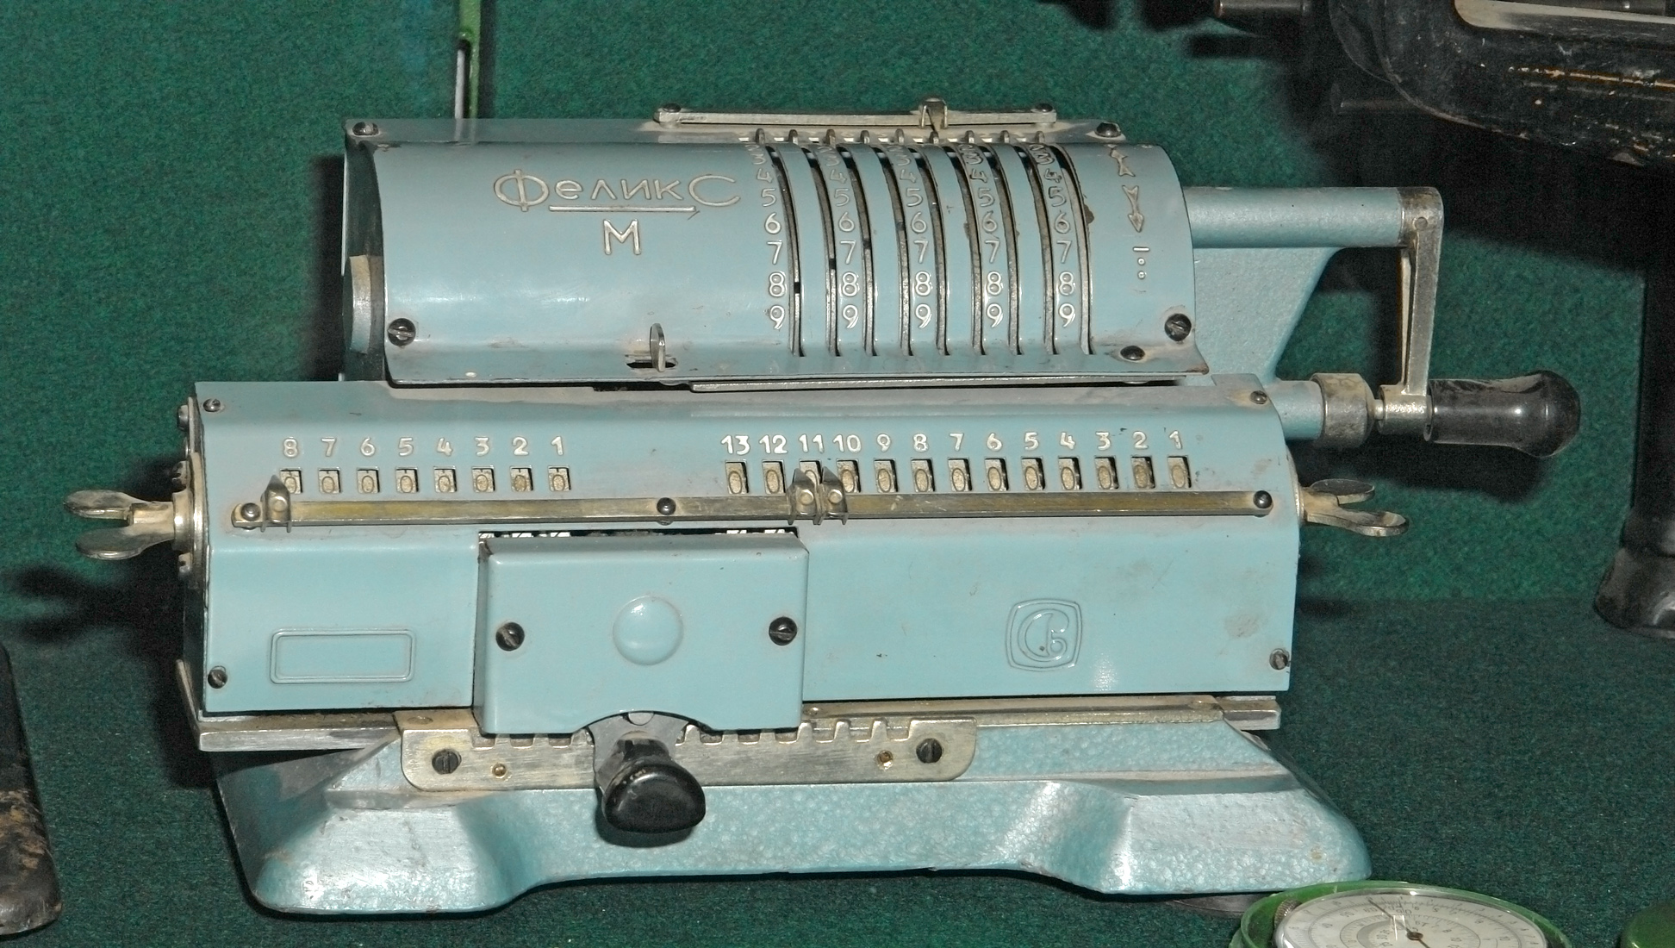
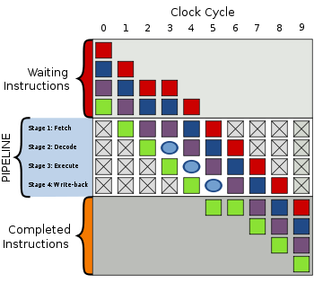
Instruction pipelining
M100
1961 IBM7030
1962 Atlas

Slide 7
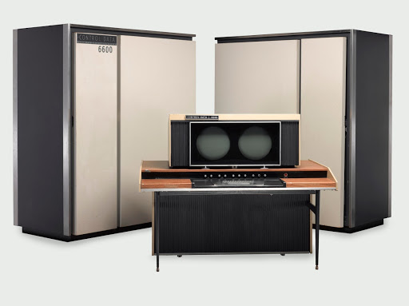
New ideas
1964 CDC-6600 by Seymour Cray – divide CPU from peripheral processors

Slide 8
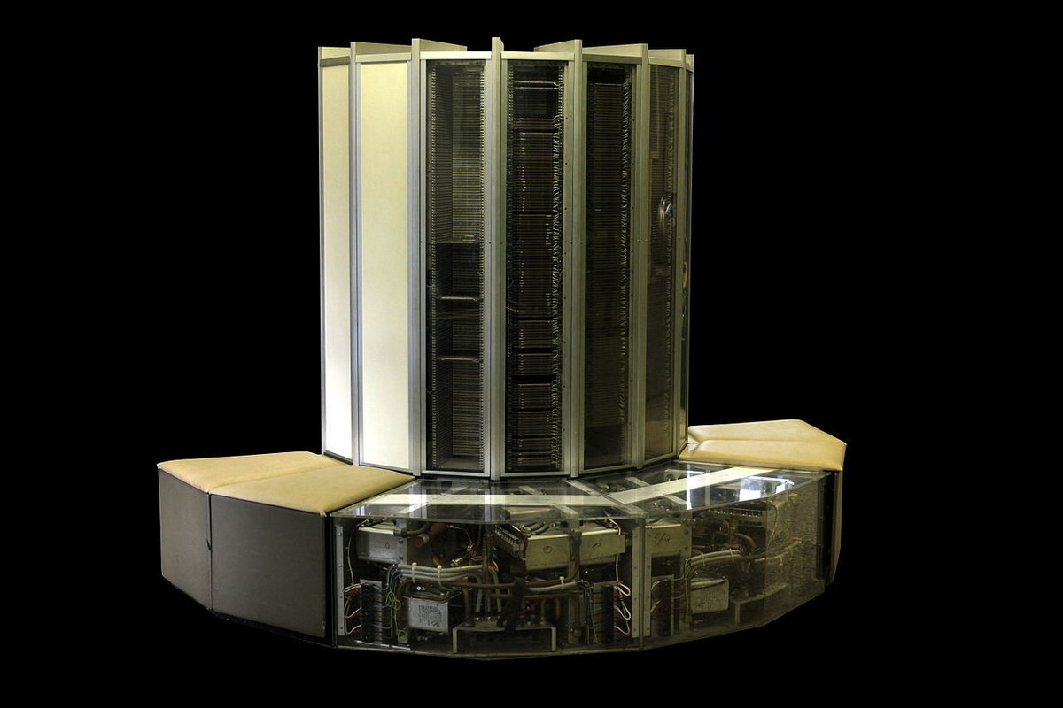
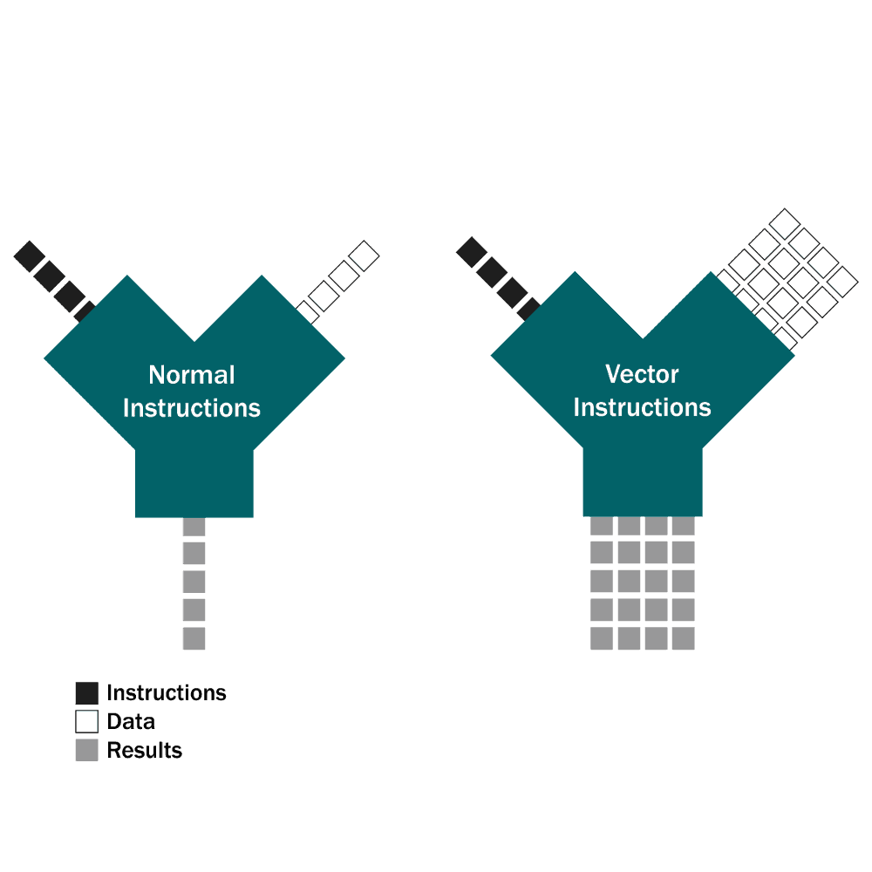
New ideas
1976 Cray1 - Vector processor

Slide 9
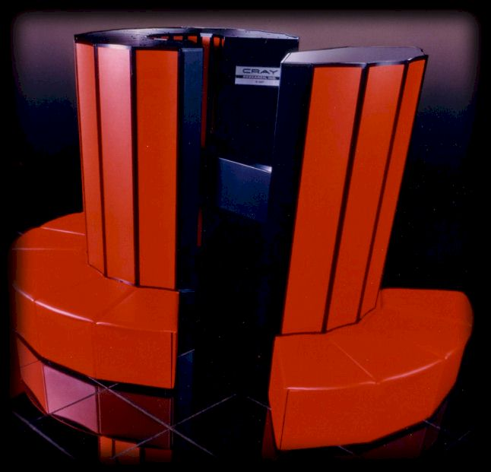
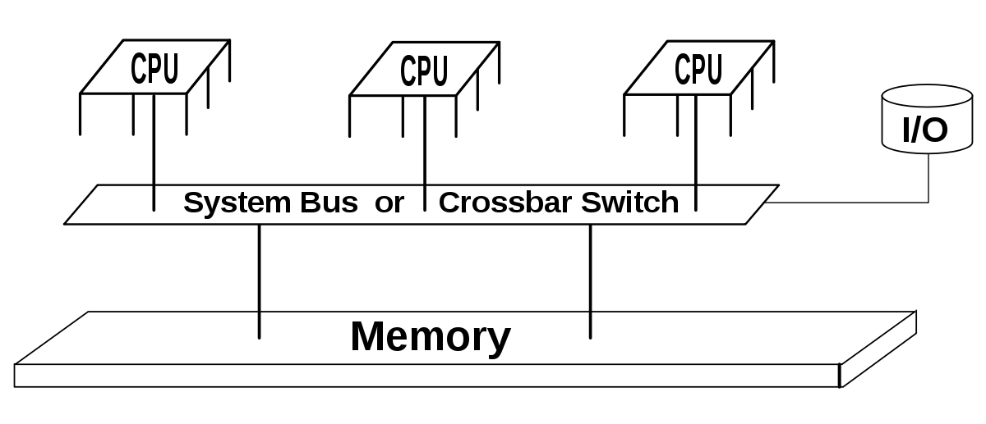
New ideas
1982 Cray X-MP – Many CPU on Shared memory

Slide 10

Performance
What determines the execution time of the program?

Slide 11
Performance
What determines the execution time of the program?
-Arithmetic operations rate
-Data feed rate

Slide 12
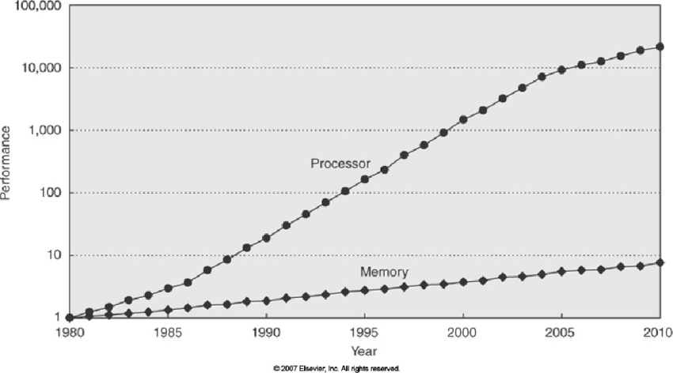
Performance
What determines the execution time of the program?
-Arithmetic operations rate
-Data feed rate

Slide 13
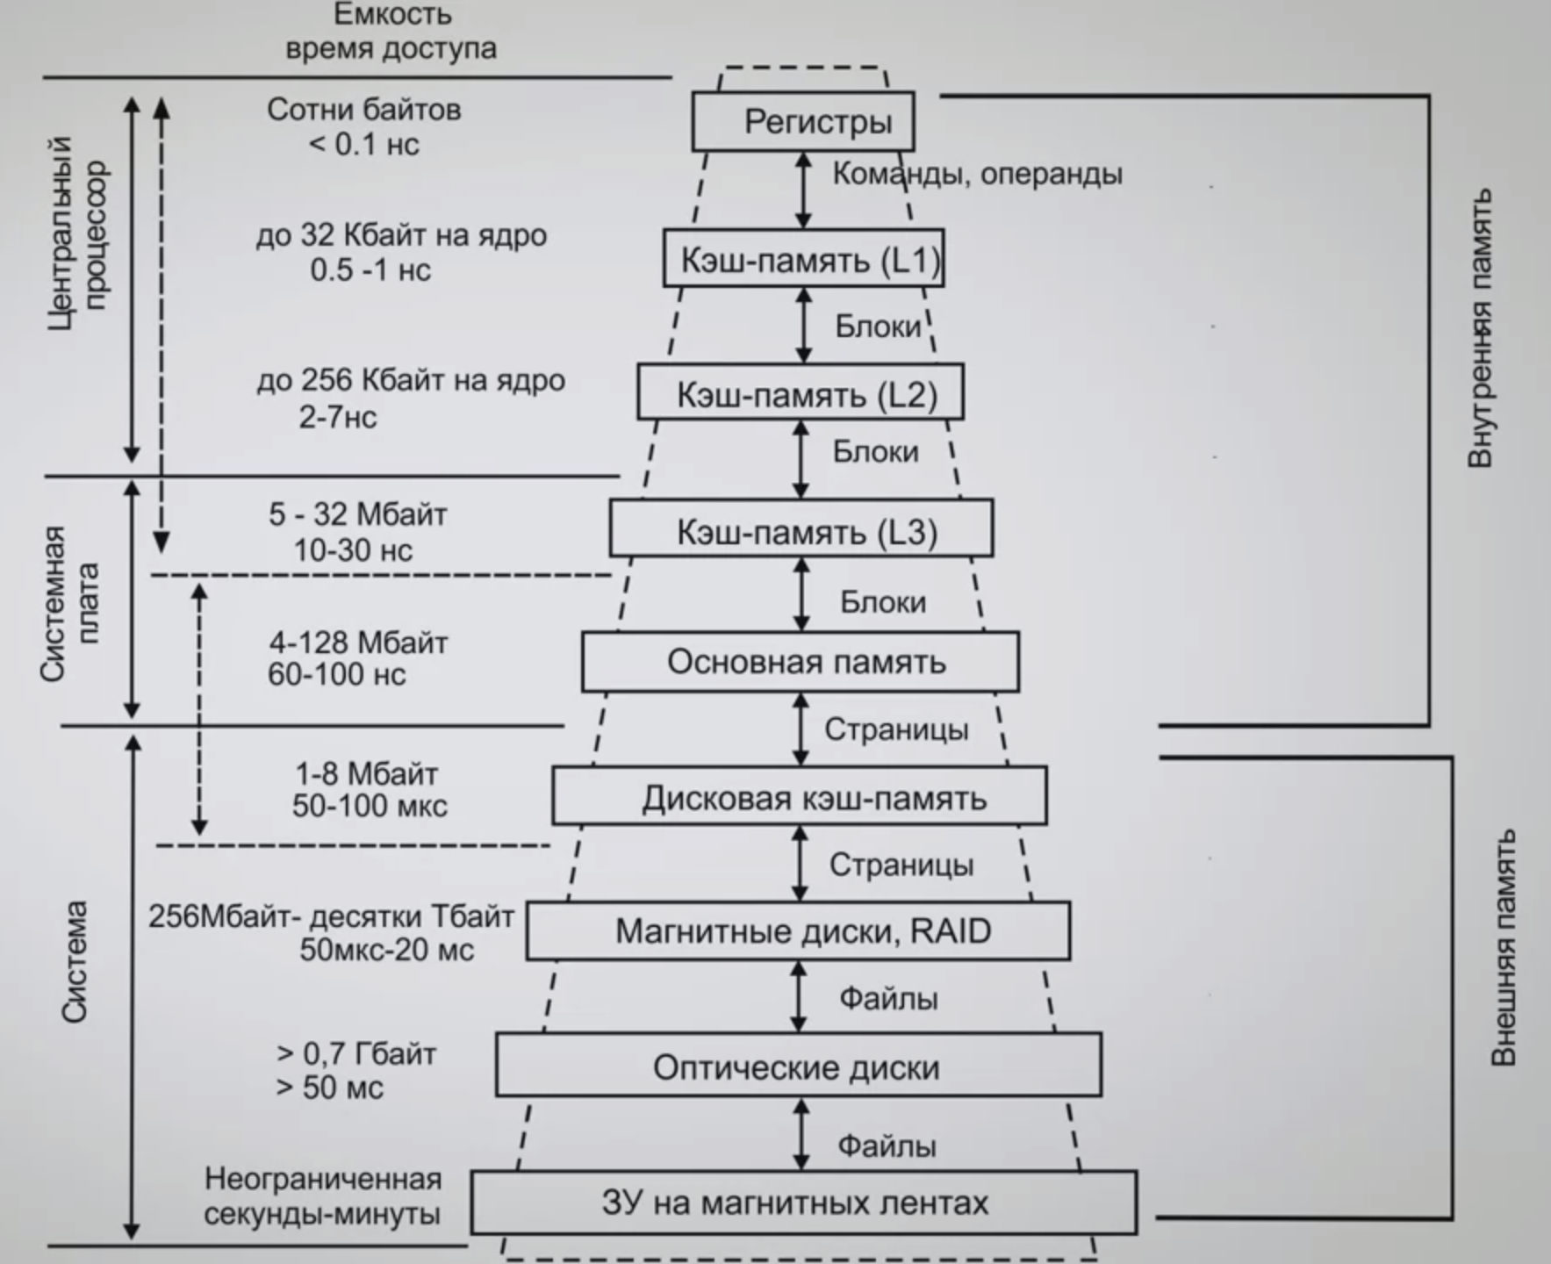
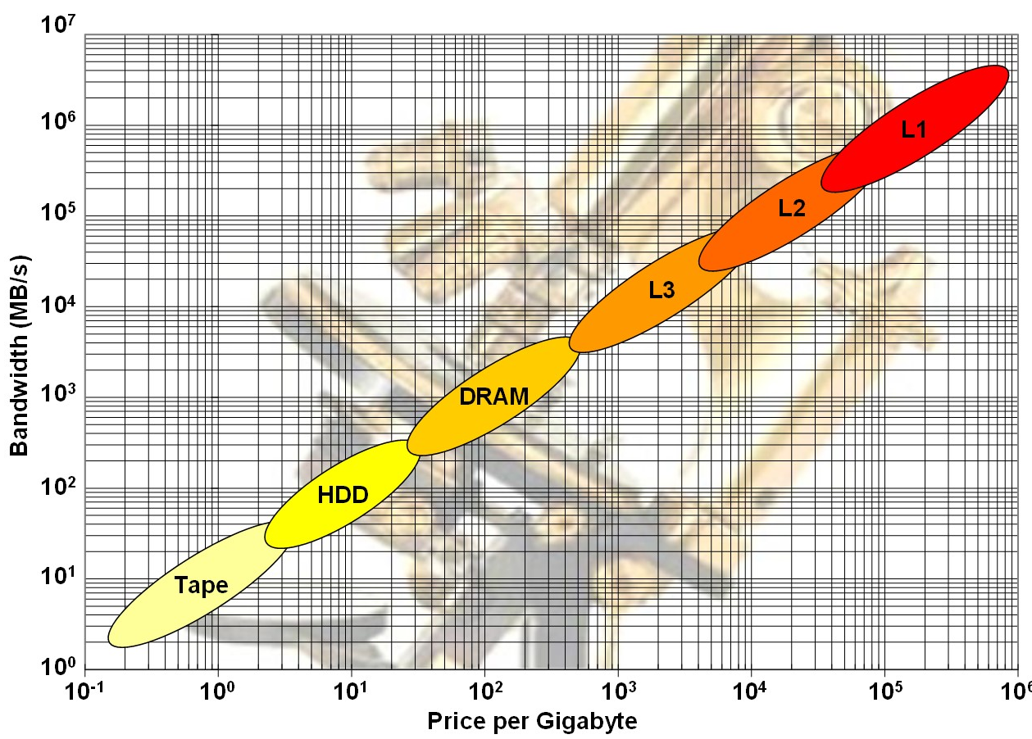
Solution
Hierarchical Memory

Slide 14
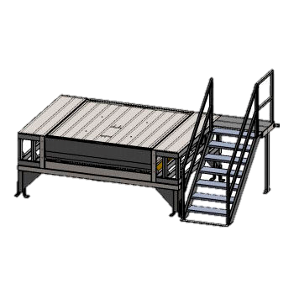
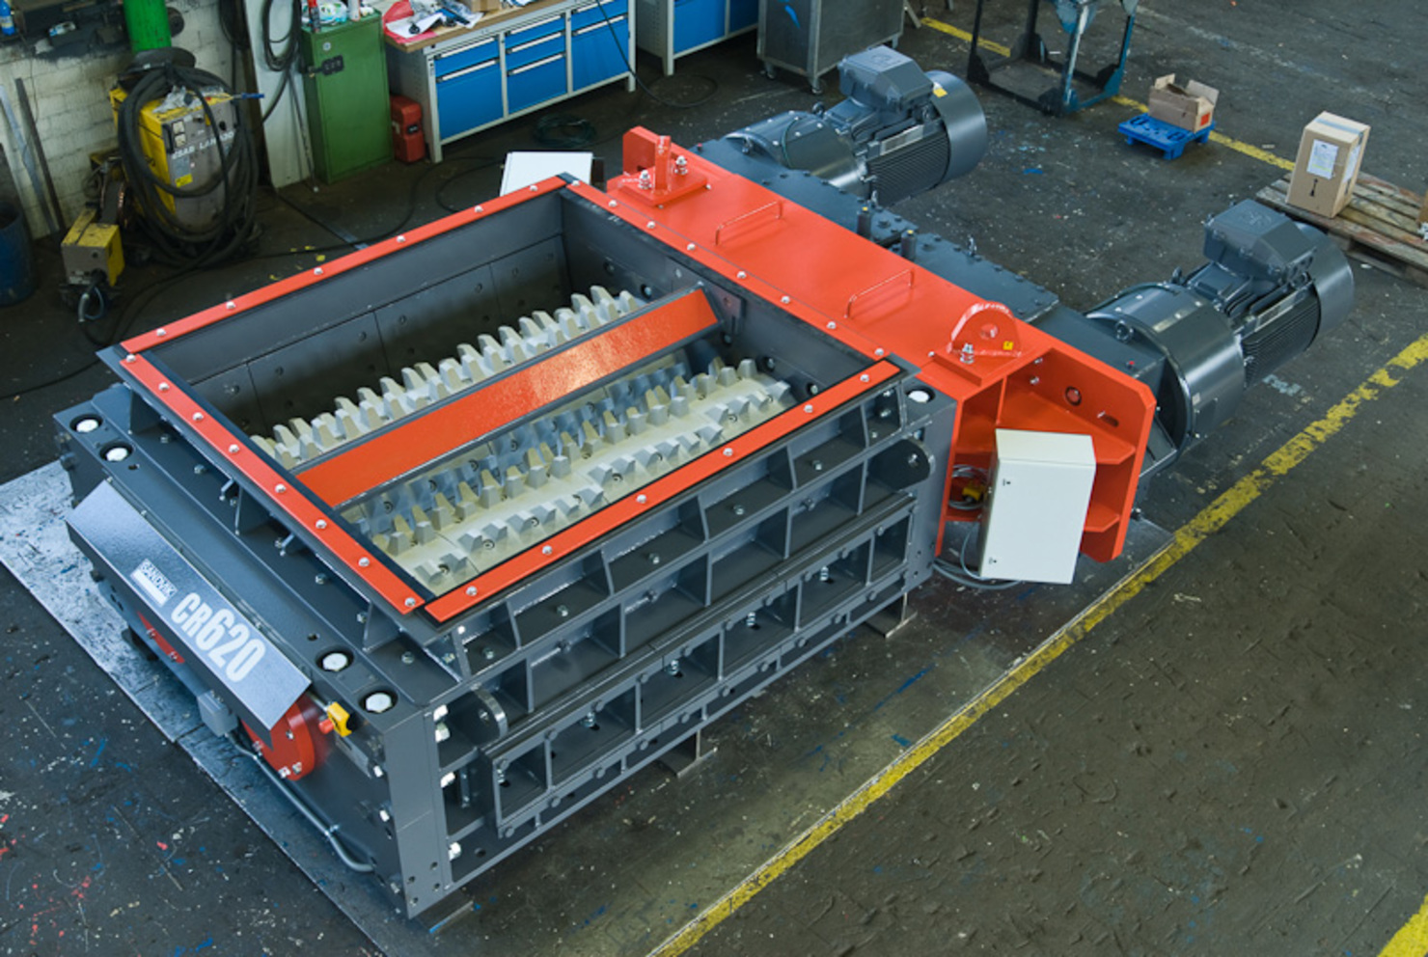
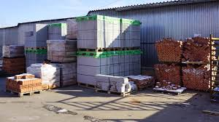

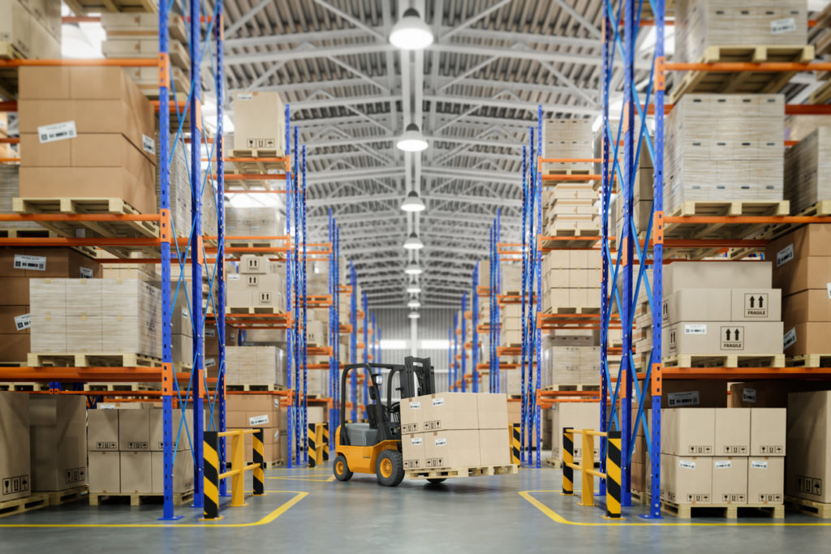
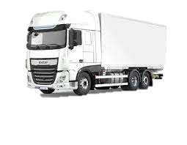
Performance
1m
100m
1000Km
Сache
Arithmetic logic unit
RAM
HDD

Slide 15
locality of reference
Temporal locality: If at one point a particular memory location is referenced, then it is likely that the same location will be referenced again in the near future.
Spatial locality: If a particular storage location is referenced at a particular time, then it is likely that nearby memory locations will be referenced in the near future.
for i in 0..n
for j in 0..m
for k in 0..p
C[i][j] = C[i][j] + A[i][k] * B[k][j];
for i in 0..n
for k in 0..m
for j in 0..p
C[i][j] = C[i][j] + A[i][k] * B[k][j];

Slide 16
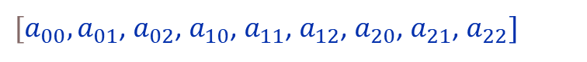
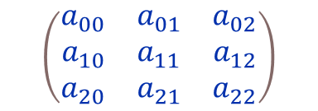
locality of reference
Matrix
$$\left(\begin{matrix}a_{00} & a_{01} & a_{02} \\ a_{10} & a_{11} & a_{12} \\ a_{20} & a_{21} & a_{22}\end{matrix}\right)$$
Memory
$[a_{00},a_{01}$, $a_{02}$, $a_{10}$, $a_{11}$, $a_{12}$, $a_{20}$, $a_{21}$, $a_{22}]$

Slide 17
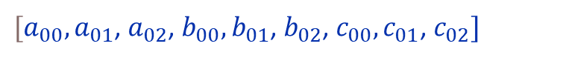
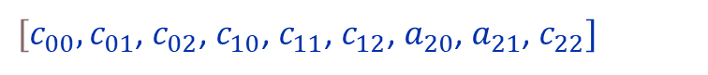
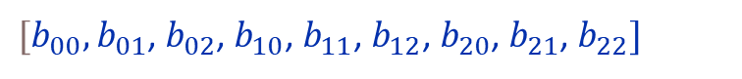
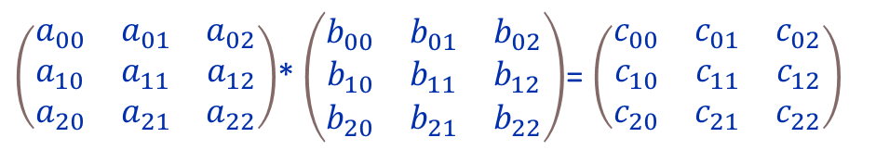
locality of reference
Matrix
$$\left(\begin{matrix}a_{00} & a_{01} & a_{02} \\ a_{10} & a_{11} & a_{12} \\ a_{20} & a_{21} & a_{22}\end{matrix}\right)$$
$\left(\begin{matrix}a_{00} & a_{01} & a_{02} \\ a_{10} & a_{11} & a_{12} \\ a_{20} & a_{21} & a_{22}\end{matrix}\right)$* $\left(\begin{matrix}b_{00} & b_{01} & b_{02} \\ b_{10} & b_{11} & b_{12} \\ b_{20} & b_{21} & b_{22}\end{matrix}\right)$= $\left(\begin{matrix}c_{00} & c_{01} & c_{02} \\ c_{10} & c_{11} & c_{12} \\ c_{20} & c_{21} & c_{22}\end{matrix}\right)$
for i in 0..n
for j in 0..m
for k in 0..p
c[i][j] = c[i][j] + a[i][k] * b[k][j];
Memory
$[a_{00},a_{01}$, $a_{02}$, $a_{10}$, $a_{11}$, $a_{12}$, $a_{20}$, $a_{21}$, $a_{22}]$
$[b_{00},b_{01}$, $b_{02}$, $b_{10}$, $b_{11}$, $b_{12}$, $b_{20}$, $b_{21}$, $b_{22}]$
$[c_{00},c_{01}$, $c_{02}$, $c_{10}$, $c_{11}$, $c_{12}$, $a_{20}$, $a_{21}$, $c_{22}]$
i=0, j=0, k=0
Registers
c[0][0] = c[0][0] + a[0][0] * b[0][0];
i=0, j=0, k=1
$[a_{00},a_{01}$, $a_{02}$, $b_{00},b_{01}$, $b_{02}$, $c_{00},c_{01}$, $c_{02}]$
c[0][0] = c[0][0] + a[0][1] * b[1][0];

Slide 18
locality of reference
Matrix
$$\left(\begin{matrix}a_{00} & a_{01} & a_{02} \\ a_{10} & a_{11} & a_{12} \\ a_{20} & a_{21} & a_{22}\end{matrix}\right)$$
$\left(\begin{matrix}a_{00} & a_{01} & a_{02} \\ a_{10} & a_{11} & a_{12} \\ a_{20} & a_{21} & a_{22}\end{matrix}\right)$* $\left(\begin{matrix}b_{00} & b_{01} & b_{02} \\ b_{10} & b_{11} & b_{12} \\ b_{20} & b_{21} & b_{22}\end{matrix}\right)$= $\left(\begin{matrix}c_{00} & c_{01} & c_{02} \\ c_{10} & c_{11} & c_{12} \\ c_{20} & c_{21} & c_{22}\end{matrix}\right)$
for i in 0..n
for k in 0..m
for j in 0..p
c[i][j] = c[i][j] + a[i][k] * b[k][j];
Memory
$[a_{00},a_{01}$, $a_{02}$, $a_{10}$, $a_{11}$, $a_{12}$, $a_{20}$, $a_{21}$, $a_{22}]$
$[b_{00},b_{01}$, $b_{02}$, $b_{10}$, $b_{11}$, $b_{12}$, $b_{20}$, $b_{21}$, $b_{22}]$
$[c_{00},c_{01}$, $c_{02}$, $c_{10}$, $c_{11}$, $c_{12}$, $a_{20}$, $a_{21}$, $c_{22}]$
i=0, j=0, k=0
Registers
c[0][0] = c[0][0] + a[0][0] * b[0][0];
i=0, j=1, k=0
$[a_{00},a_{01}$, $a_{02}$, $b_{00},b_{01}$, $b_{02}$, $c_{00},c_{01}$, $c_{02}]$
c[0][1] = c[0][1] + a[0][0] * b[0][1];

Slide 19
locality of reference
Matrix
$$\left(\begin{matrix}a_{00} & a_{01} & a_{02} \\ a_{10} & a_{11} & a_{12} \\ a_{20} & a_{21} & a_{22}\end{matrix}\right)$$
$\left(\begin{matrix}a_{00} & a_{01} & a_{02} \\ a_{10} & a_{11} & a_{12} \\ a_{20} & a_{21} & a_{22}\end{matrix}\right)$* $\left(\begin{matrix}b_{00} & b_{01} & b_{02} \\ b_{10} & b_{11} & b_{12} \\ b_{20} & b_{21} & b_{22}\end{matrix}\right)$= $\left(\begin{matrix}c_{00} & c_{01} & c_{02} \\ c_{10} & c_{11} & c_{12} \\ c_{20} & c_{21} & c_{22}\end{matrix}\right)$
for j in 0..n
for k in 0..m
for i in 0..p
c[i][j] = c[i][j] + a[i][k] * b[k][j];
Memory
$[a_{00},a_{01}$, $a_{02}$, $a_{10}$, $a_{11}$, $a_{12}$, $a_{20}$, $a_{21}$, $a_{22}]$
$[b_{00},b_{01}$, $b_{02}$, $b_{10}$, $b_{11}$, $b_{12}$, $b_{20}$, $b_{21}$, $b_{22}]$
$[c_{00},c_{01}$, $c_{02}$, $c_{10}$, $c_{11}$, $c_{12}$, $a_{20}$, $a_{21}$, $c_{22}]$
i=0, j=0, k=0
Registers
c[0][0] = c[0][0] + a[0][0] * b[0][0];
i=1, j=0, k=0
$[a_{00},a_{01}$, $a_{02}$, $b_{00},b_{01}$, $b_{02}$, $c_{00},c_{01}$, $c_{02}]$
c[1][0] = c[1][0] + a[1][0] * b[0][0];

Slide 20

locality of reference
Matrix
$$\left(\begin{matrix}a_{00} & a_{01} & a_{02} \\ a_{10} & a_{11} & a_{12} \\ a_{20} & a_{21} & a_{22}\end{matrix}\right)$$
$\left(\begin{matrix}a_{00} & a_{01} & a_{02} \\ a_{10} & a_{11} & a_{12} \\ a_{20} & a_{21} & a_{22}\end{matrix}\right)$* $\left(\begin{matrix}b_{00} & b_{01} & b_{02} \\ b_{10} & b_{11} & b_{12} \\ b_{20} & b_{21} & b_{22}\end{matrix}\right)$= $\left(\begin{matrix}c_{00} & c_{01} & c_{02} \\ c_{10} & c_{11} & c_{12} \\ c_{20} & c_{21} & c_{22}\end{matrix}\right)$
for j in 0..n
for k in 0..m
for i in 0..p
c[i][j] = c[i][j] + a[i][k] * b[k][j];
Memory
$[a_{00},a_{01}$, $a_{02}$, $a_{10}$, $a_{11}$, $a_{12}$, $a_{20}$, $a_{21}$, $a_{22}]$
$[b_{00},b_{01}$, $b_{02}$, $b_{10}$, $b_{11}$, $b_{12}$, $b_{20}$, $b_{21}$, $b_{22}]$
$[c_{00},c_{01}$, $c_{02}$, $c_{10}$, $c_{11}$, $c_{12}$, $a_{20}$, $a_{21}$, $c_{22}]$
ijk
jki
ikj
Registers
$[a_{00},a_{01}$, $a_{02}$, $b_{00},b_{01}$, $b_{02}$, $c_{00},c_{01}$, $c_{02}]$

Slide 21
Approaches to increasing CPU performance

Slide 22
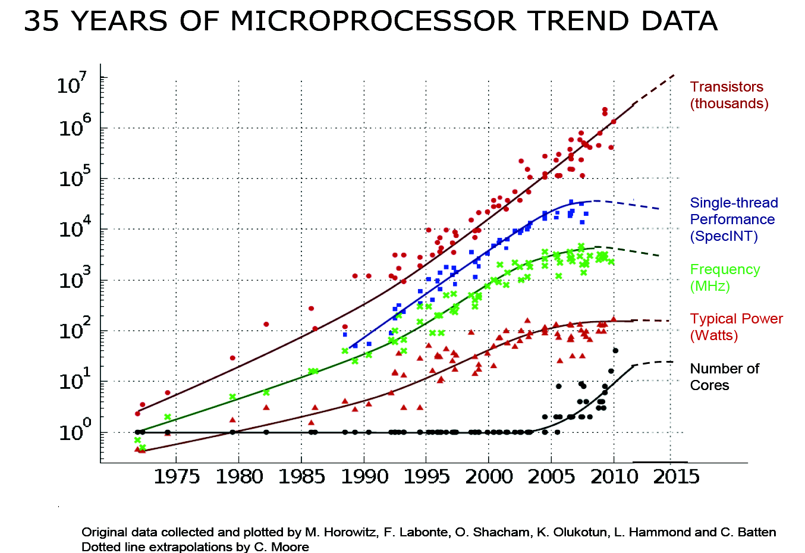
Approaches to increasing CPU performance

Slide 23
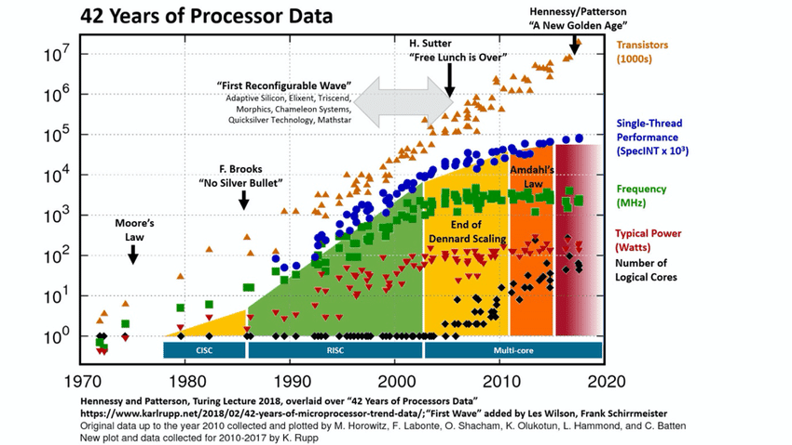
Approaches to increasing CPU performance

Slide 24
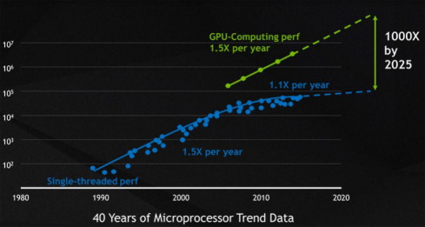
Approaches to increasing CPU performance

Slide 25
What are supercomputers for?
quantum mechanics,
weather forecasting,
climate research,
oil and gas exploration,
molecular modeling (computing the structures and properties of chemical compounds, biological macromolecules, polymers, and crystals),
physical simulations (such as simulations of the early moments of the universe, airplane and spacecraft aerodynamics, the detonation of nuclear weapons, and nuclear fusion),
and many others

Slide 26
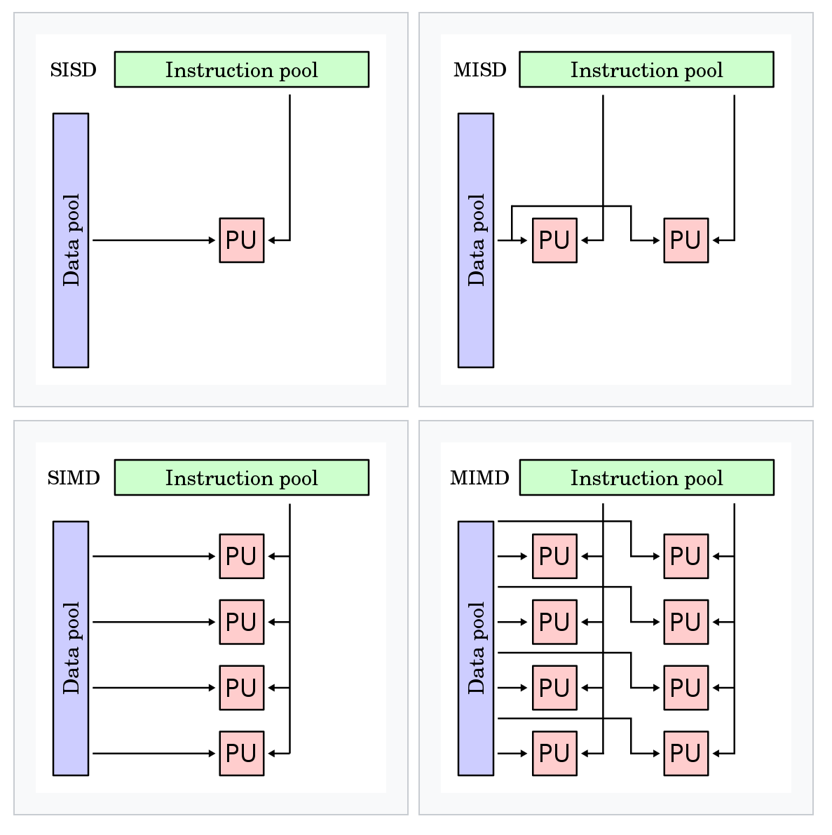
Flynn's taxonomy
single instruction
multiple instruction
single data
multiple data

Slide 27

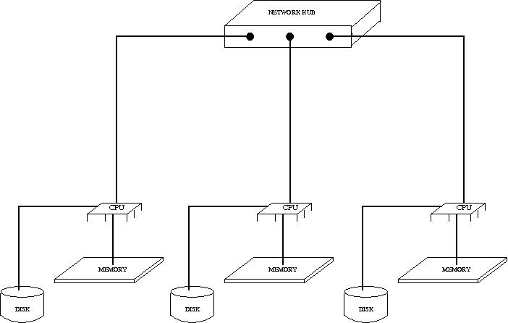
Systematization by access to memory
Shared memory
Distributed memory

Slide 28
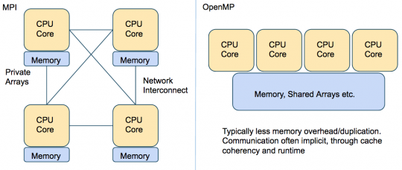
Parallel applications realization
Distributed memory
Shared memory
MPI (Message Passing Interface) is a standardized and portable message-passing standard designed to function on parallel computing architectures.
OpenMP (Open Multi-Processing) is an application programming interface (API) that supports multi-platform shared-memory multiprocessing programming.

Slide 29
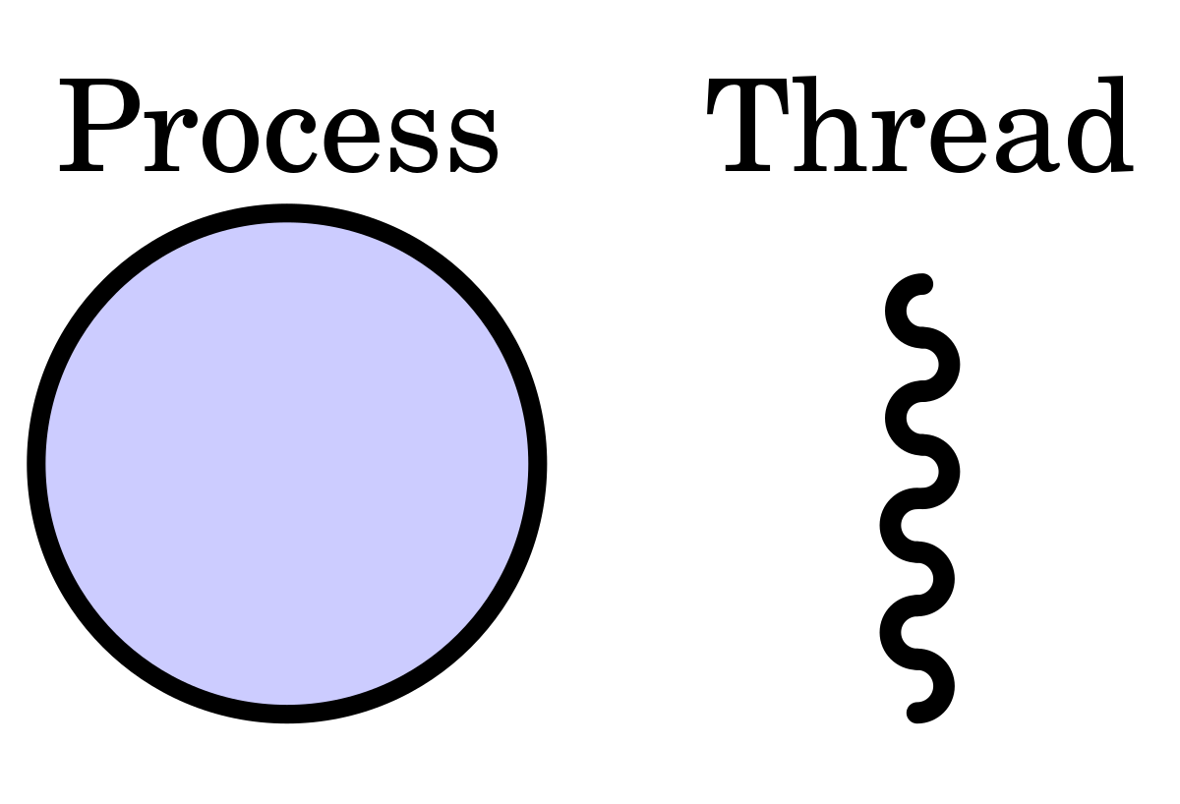
Process and Thread

Slide 30
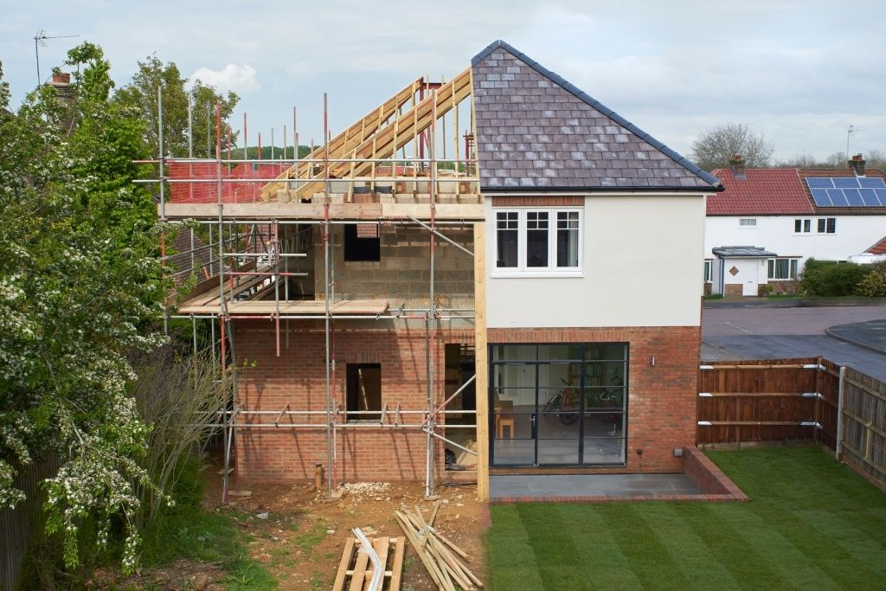
Process and Thread
The task is to build a house
What do you need?

Slide 31
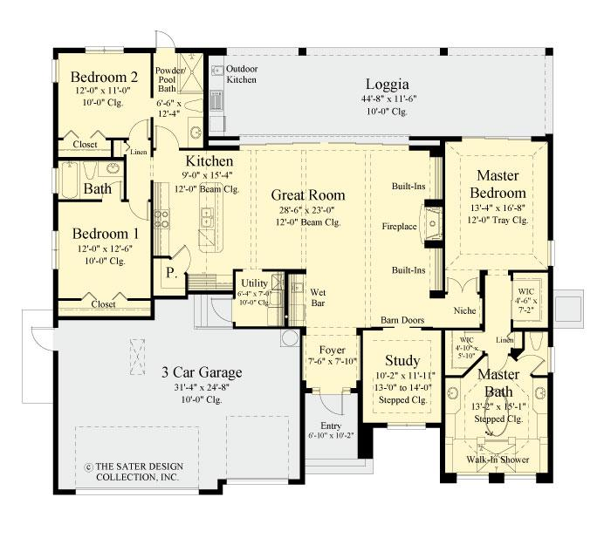
Process and Thread
The task is to build a house
What do you need?
Project

Slide 32

Process and Thread
The task is to build a house
What do you need?
Project
Materials
and instruments

Slide 33
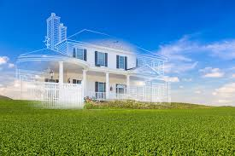
Process and Thread
The task is to build a house
What do you need?
Project
Materials
and instruments
Land

Slide 34

Process and Thread
The task is to build a house
What do you need?
Project
Materials
and instruments
Workers
Land

Slide 35
Process and Thread
The task is to build a house
What do you need?
Project = Program
All of these is Process
Materials
and instruments = Data
Workers = Threads
Land = Address space

Slide 36
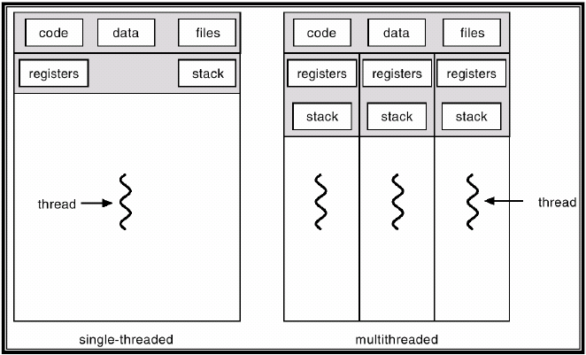
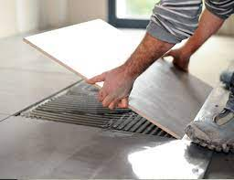

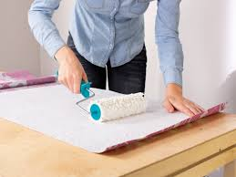
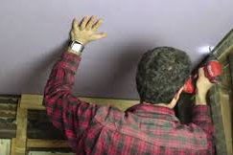
Process and Thread
Process – is a “container” for threads
Processes are isolated from each other, and threads can run in the same process.

Slide 37
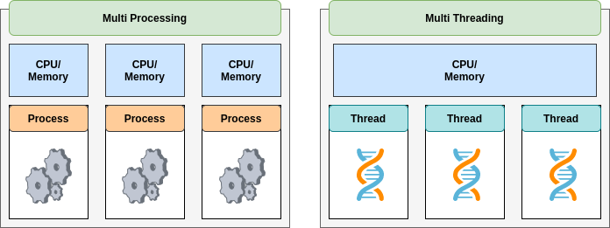
Multi Threading
Multi-threaded programming is only possible on shared memory systems.

Slide 38
OpenMP

Slide 39
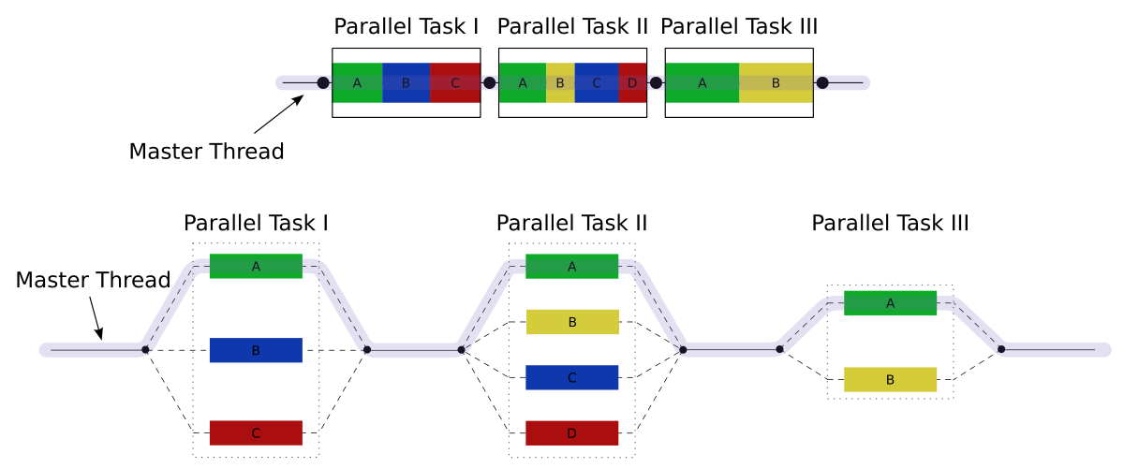
OpenMP
Fork – join parallelism

Slide 40
OpenMP
One version of the program for parallel and sequential execution.
SPMD (Single Program Multiple Data) model of parallel programming: the same code is used for all parallel threads.
OpenMP includes:
compiler directives
helper function
environment variables

Slide 41
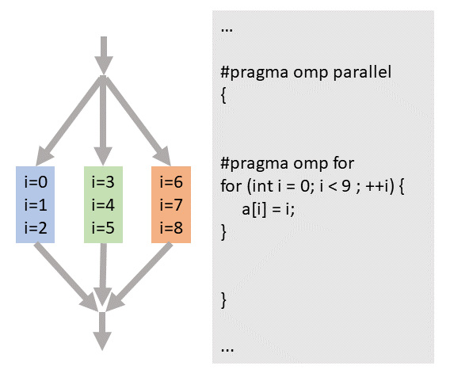
OpenMP
Basics directives embed directly into serial code
#pragma omp directive-name (clause((,) clause)...)

Slide 42
OpenMP
#include <omp.h> #include <iostream>
using namespace std;
int main() {
int a[100],b[100],c[100];
for (int i=0;i<100;i++)
{
a[i]=1;
b[i]=1;
}
for (int i=0;i<100;i++)
{
c[i]=a[i]+b[i];
}
}
#include <omp.h> #include <iostream>
using namespace std;
int main() {
int a[100],b[100],c[100];
#pragma omp parallel for
for (int i=0;i<100;i++)
{
a[i]=1;
b[i]=1;
}
#pragma omp parallel for
for (int i=0;i<100;i++)
{
c[i]=a[i]+b[i];
}
}

Slide 43
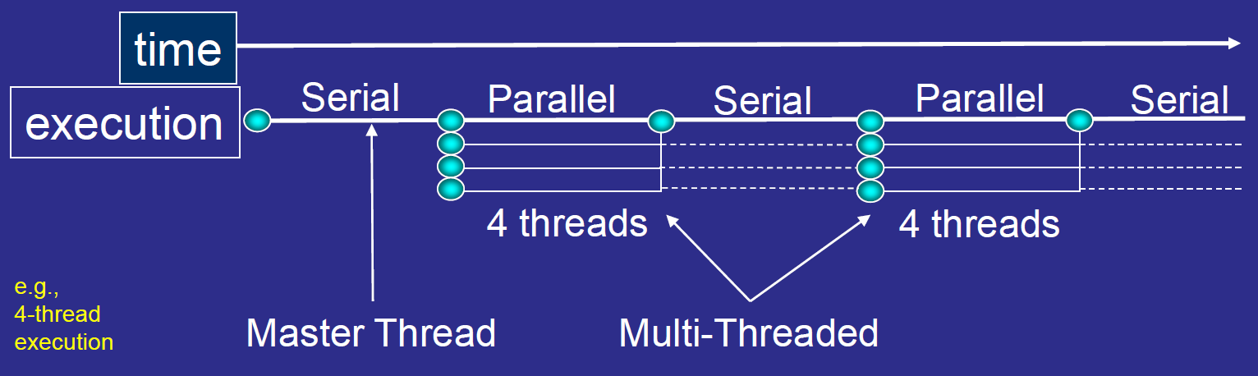
OpenMP
When the program starts, the main thread or master is spawned.
Only the main thread executes all sequential blocks of the program.

Slide 44
OpenMP
For create additional threads for parallel section you should write directive
#pragma omp parallel (clause((), clause)…)
{
\\ parallel code
}

Slide 45
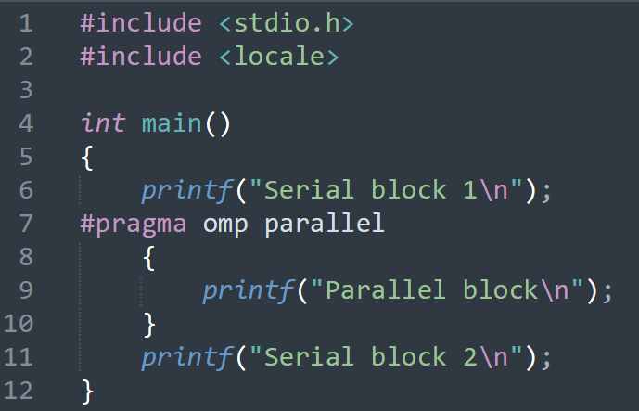
OpenMP
For create additional threads for parallel section you should write directive
#pragma omp parallel (clause((), clause)…)
{
\\ parallel code
}

Slide 46
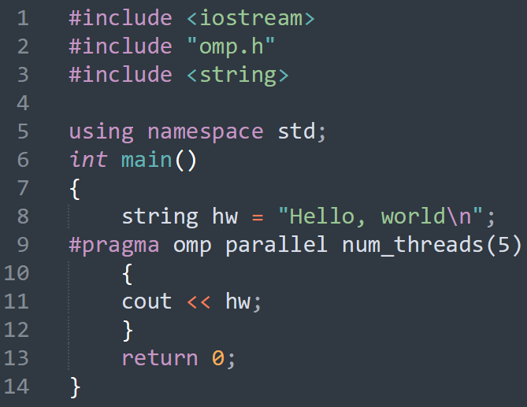
OpenMP
For create additional threads for parallel section you should write directive
#pragma omp parallel num_threads(5)
#pragma omp parallel if (condition)

Slide 47
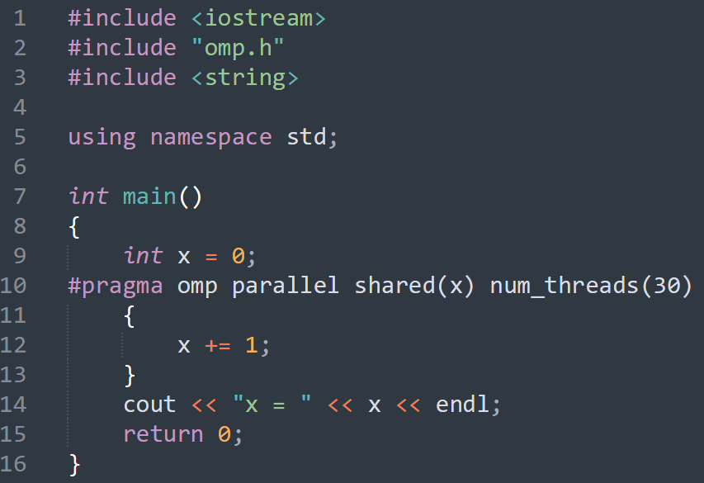
OpenMP
Memory model. Variable Classes in OpenMP
Shared
Data race

Slide 48
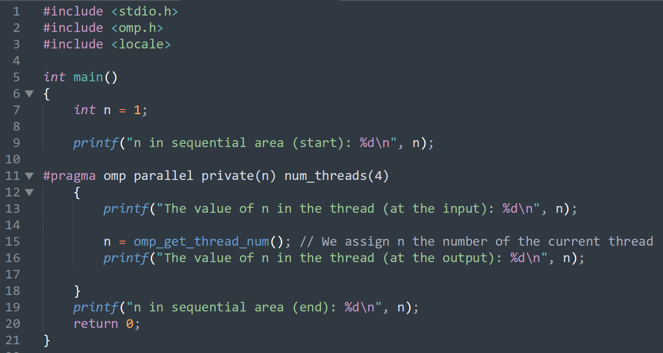
OpenMP
Memory model. Variable Classes in OpenMP
Shared
Private
Data race

Slide 49
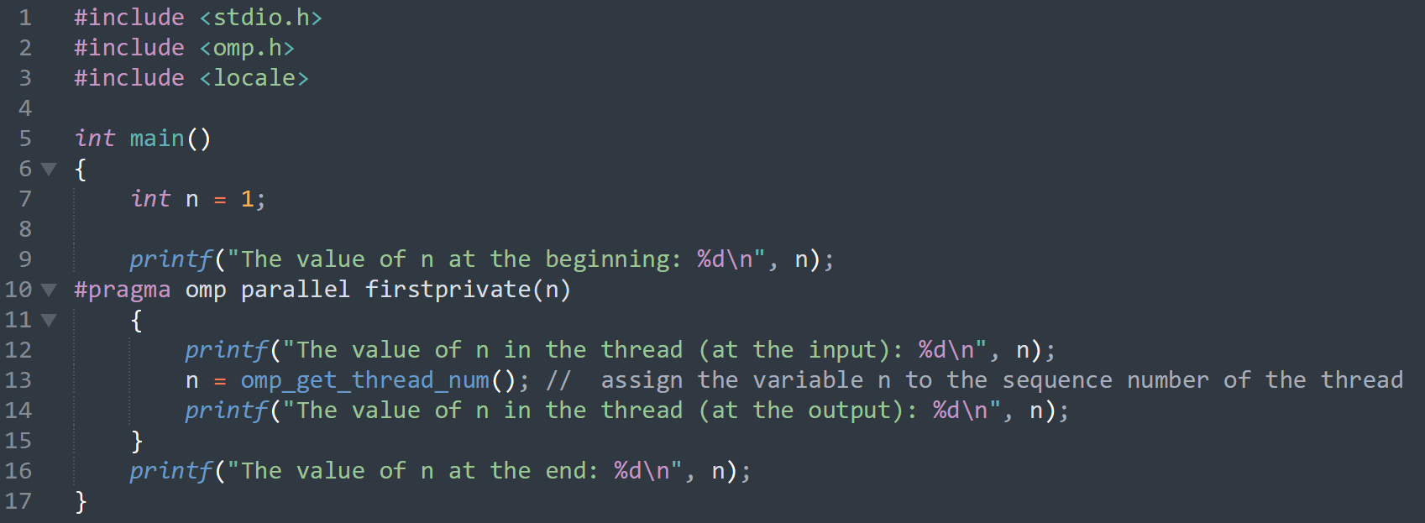
OpenMP
Memory model. Variable Classes in OpenMP
private – create local variable for each thread
firstprivate – create local variable for each thread with initialization from previous serial part.

Slide 50
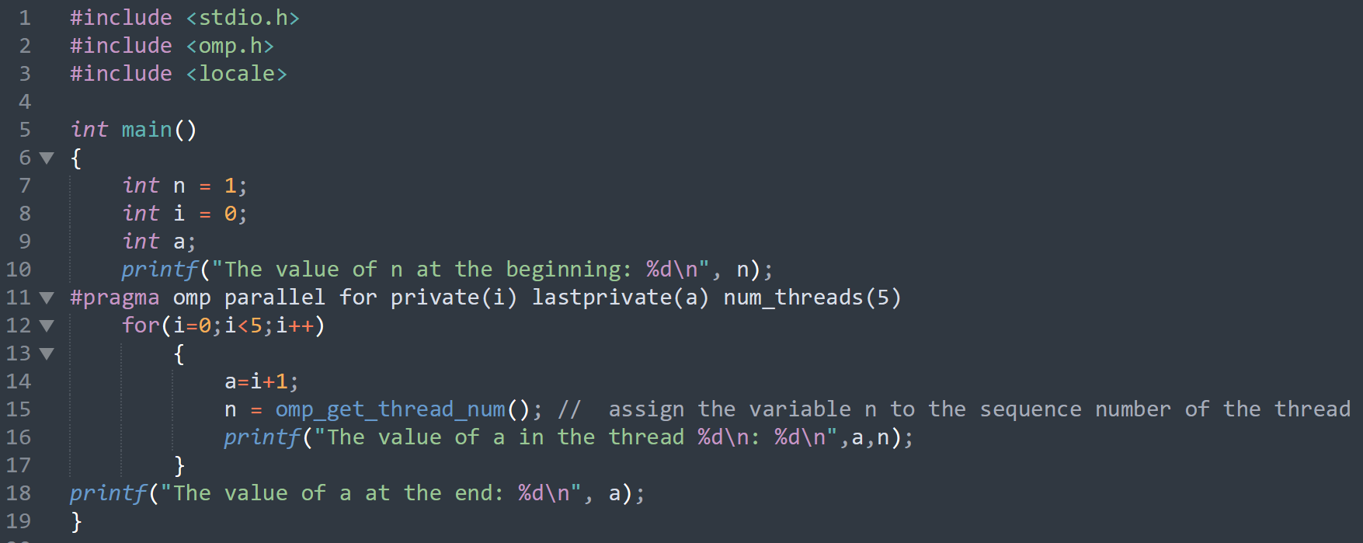
OpenMP
Memory model. Variable Classes in OpenMP
private – create local variable for each thread
lastprivate – create variable after parallel part with initialization from last parallel section.

Slide 51
OpenMP
Memory model. Variable Classes in OpenMP
shared
firstprivate
private
lastprivate
reduction

Slide 52

OpenMP
Memory model. Variable Classes in OpenMP
reduction
specifies an operator and a list of common variables; local copies are created for each variable in each thread; they are initialized according to the type of the operator (for additive - 0 or analogs, for multiplicative - 1 or analogs); after all the operators of the parallel region are executed, the specified operator is executed;

Slide 53

OpenMP
Modes of execution of multithreaded programs
single
private
firstprivate
copyprivate
nowait

Slide 54

OpenMP
Modes of execution of multithreaded programs
single
nowait

Slide 55

OpenMP
Modes of execution of multithreaded programs
master

Slide 56

OpenMP
Parallelizing loops

Slide 57

OpenMP
Parallelizing loops
Without omp
With omp

Slide 58

OpenMP
Parallelizing loops
With omp, parallel for

Slide 59


Process and Thread
1.We cannot parallelize all processes. There will always be serial parts.

